Slide 1

SMART HEALTH MONiTORING SYSTEM

Slide 2
Contents
Introduction
Existing system with Proposed system
System Architecture
Sub-System Architecture
Work Completed
Conclusion
Cos & CO-PO Mapping
References

Slide 3
Introduction
Health is a fundamental element of people’s need for a better life . the global health problem has created a because of certain factors such as poor health services, the presence of large gaps between rural and urban areas, physicians, and nurses unavailability during the hardest time.
To overcome this, IOT is best platform, because in rapid growth of technologies wireless technology is ruling worldwide.
We are developing Smart Health Monitoring System(SHMS), is to solve the health related problem, SHMS is device comprised of different sensors to acquire the information regarding Human body temperature , heart rate , further transmit this information on the IOT sever then Doctor can accessible over the internet

Slide 4
2.Existing system with Proposed system
Existing System :-
There no proper format view the data For the Doctor.
Issues in Power supply.
Proposed System :-
We proposed a nonstop health tracking.
The patient Health condition data store the patient information’s in server.
Solar Power Used to SHMS.

Slide 5
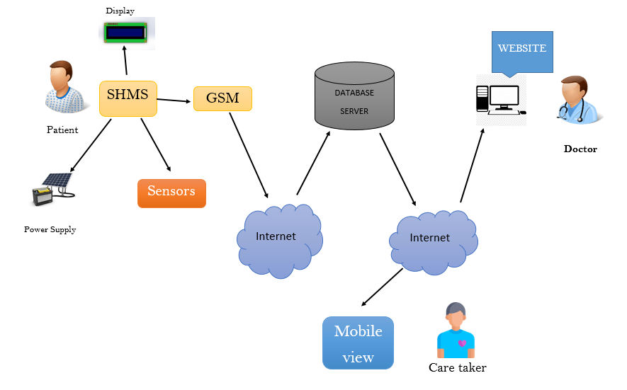
3.System Architecture

Slide 6
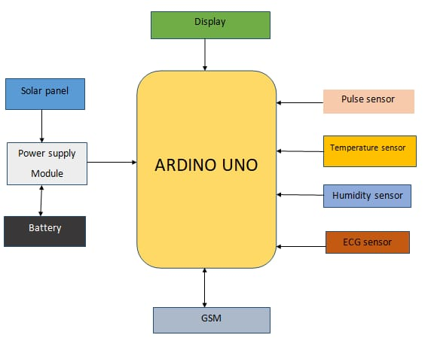
4.Sub-System Architecture

Slide 7
5.Work Completed
Sensors Part Completed and Integrated Power Supply.
Power Supply With Solar Is Completed.
Connecting With Internet is Completed.

Slide 8
6.Conclusion
An efficient SHMS is developed to monitor the up to date status of the patient irrespective of the presence of the doctor.
The system collects information like temperature, blood pressure and pulse rate of the patient and updates the same to the doctor.
The system is evaluated experimentally and collected the sample data of ten patients to verify the status of patients.

Slide 9
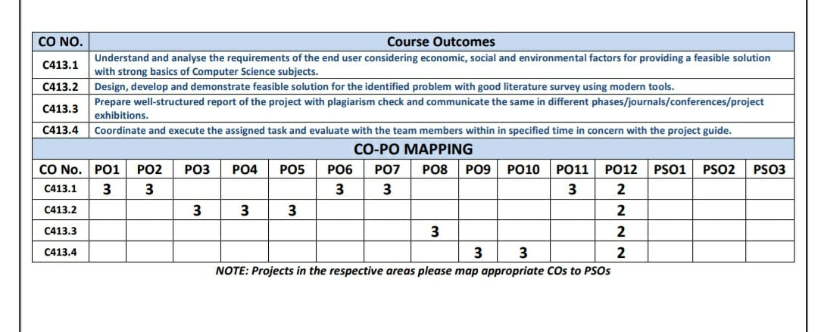
7.Cos & CO-PO Mapping

Slide 10
References
Rahaman A, Islam M, Islam M, Sadi M, Nooruddin S. Developing IoT based smart health monitoring systems: a review. Rev Intell Arrive. 2019;33:435–40. https://doi.org/10.18280/ria.330605.
Lin T, Rivano H, Le Mouel F. A survey of smart parking solutions. IEEE Trans Intell Transp Syst. 2017;18:3229–53. https://doi.org/10.1109/TITS.2017.2685143

Slide 11

THANK YOU

